Slide 1




Is Your Proposal a Winner?
Emory Prevention Research Center
Rollins School of Public Health
May 14, 2014

Slide 2
EPRC
The Emory Prevention Research Center proudly presents this webinar on planning for grant proposals. All materials will be available at www.sph.emory.edu/eprc.
The Emory Prevention Research Center is a member of the Prevention Research Centers Program, supported by the Centers for Disease Control and Prevention cooperative agreement number U48 DP001909. The findings and conclusions on these pages are those of the authors and do not necessarily represent the official position of the Centers for Disease Control and Prevention.

Slide 3

EPRC
Focuses on community-based cancer prevention and reducing health disparities in the rural communities of Southwest Georgia
Works with community partners and focuses on primary prevention (tobacco, physical activity, and nutrition; including reduction of overweight/obesity)

Slide 4


Goals of EPRC
Promote prevention research
Conduct research on cancer prevention
Deliver training and education
Communicate new findings and our results
Provide technical assistance for research
and evaluation

Slide 5
Welcome
Welcome
How to Use Adobe Connect
Evaluation survey
Q&A
Participation Encouraged!
Handout

Slide 6
How to Use Adobe Connect
Please put your phone on mute!
To respond to a poll:
  A poll will appear on your screen
  Click the appropriate response
  Your answer will be recorded for the host to view
To ask a question:
  use the raise your hand icon

Slide 7
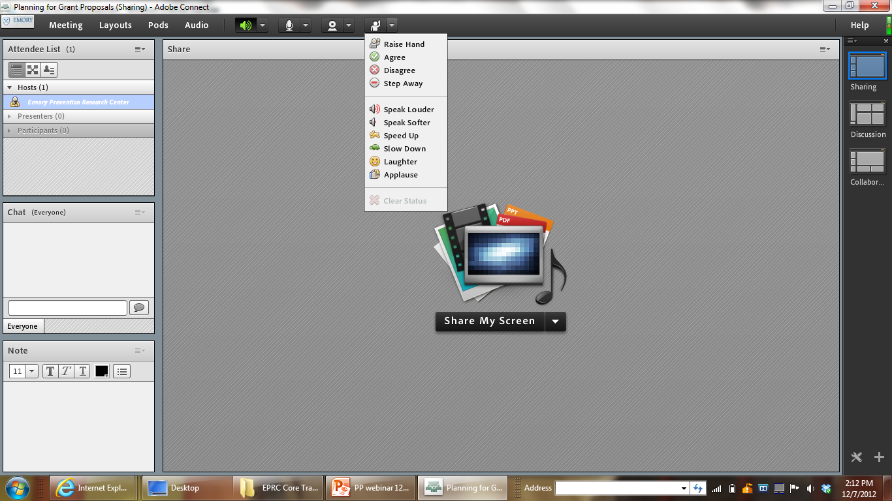

Slide 8
Training Objectives
Discuss the common pitfalls of the grant proposal review and submission process
Describe the different types of grant review processes
Determine what grant reviewers look for in a grant proposal

Slide 9
Q&A
Have you submitted a grant proposal before?
  Yes
  No

Slide 10
Q&A
On a scale from 1 to 10, how enjoyable was your experience of submitting a grant proposal?

Slide 11
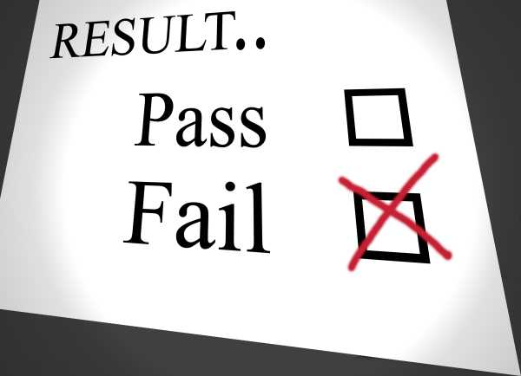
Bottom Line
We like to judge others work more than we like to have our own work judged!

Slide 12
Today’s Training
Today we will talk about how we can incorporate what reviewers look for in grant proposals
One thing to note is that all review processes are different so what we present today are general in context
Review the grant application info or ask the funder for specific review/evaluation criteria

Slide 13
Reviewing and Submitting your Proposal

Slide 14
Grant Sections
Section | Description
Coverletter | Letter describing project name, purpose of project, budget requested, timeline and agency contact
Problem need | Identification of the problem or need addressed by the project
Project goal | Goals/objectives of project
Project description | Narrative about the program objectives, activities, strategies, staffing, partners, and timeline Explanation of how the project will address the problem or need
Budget | Amount of costs and explanation of the costs for the project
Supporting materials/Appendices | Letters of support Other required forms (e.g., organizational chart, tax status, organizational information)

Slide 15
Budget
Tabular display of total dollars requested for the project
  Common sections: Personnel, Travel, Supplies, and Other
  Includes total amount request, in-kind/donated funds, and indirect costs
A budget narrative should:
  Explain what the numbers represent and how they were calculated
  Connect figures to overall proposal objectives
  Detailed explanation of how you will spend each line in budget

Slide 16
Why Grants Fail…
Problem: The grant proposal is unresponsive to the grantor’s requirements
  Grant writer did not read the instructions carefully
  Grant writer is unaware of the requirements/ eligibility
  Grant writer leaves out a required component
Solution: Ensure that all criteria are met

Slide 17
Why Grants Fail…
Problem: The grant proposal is difficult to read or is not concise
  The grant writer uses incorrect grammar or incorrect terms
  The flow of the proposal is not logical and is hard for reviewers to follow
Solution: Have colleagues/officials review your work before submitting

Slide 18

Before Submitting the Proposal
Final review of grant proposal:
  Completeness
  Compliance
  Conciseness
  Consistency between parts
  Clarity of narrative
  Computations
  Compilation

Slide 19
Before Submitting the Proposal
Make sure that you have included all the required documents
  501(c)3 documentation
  Resumes of staff members assigned to proposed program
  Contact person and information at your organization
  Letters of support
  Accurate and realistic budget that aligns with objectives

Slide 20
Preparation and Submittal
Submitting the Grant
  Approval and signature process
  Delivery of grant
    Submitting electronically- pdf, word file, zip file
    Copying and mailing – number of copies requested
Follow-up
  If sent electronically, follow up immediately to ensure that the funder received and can open all of your application

Slide 21

Questions ?
So far…….

Slide 22
Q&A
Have you reviewed a grant proposal before?
  Yes
  No

Slide 23
Q&A
On a scale from 1 to 10, how enjoyable was your experience of reviewing a grant proposal?

Slide 24

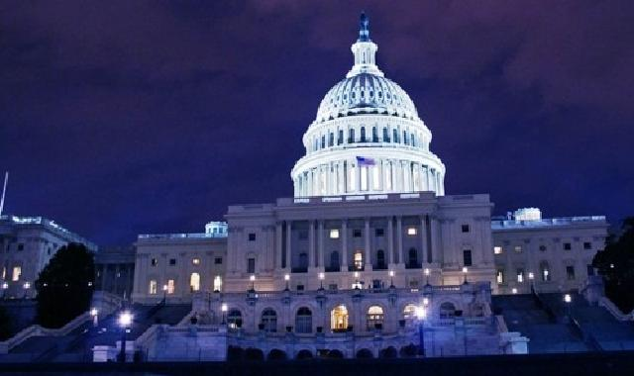

Grants Reviews

Slide 25

General Grant Review
Funder reviews all applications makes a decision
Time it will take to hear back from a funder can vary greatly from organization to organization
Funders have different review processes and schedules. Some review proposals once a year, while others review on an ongoing basis

Slide 26
Grant Review Processes
Various methods by different types of funders; foundations and government agencies have different processes
Systematic process
Examine grant application for criteria for review and pay attention to points to evaluate each grant section

Slide 27

Grant Reviewers
Selection based on:
  Experience with funder (e.g., staff, board members)
  Expertise on health issue, priority areas of funding, technique or methods
  Availability for written reviews and/or oral panel
  No conflict of interest (i.e., vested interests in the outcomes of the application)

Slide 28
Grant Review: Foundations

Slide 29
Grant Review: Foundations
Review Committee rates proposals based on:
Level of expertise
Step-by-step procedure
Programmatic person to answer questions
Scientific and technical merits assessed
Documentation
Feedback on proposals is usually given

Slide 30
Grant Review: Foundations
Single person
Small group review
Formal review panel/Committee

Slide 31
Review Criteria: Foundations
Significance
People (qualified, capable)
Organization
Plan (organized, carefully thought out)
Results/evaluation (use of results, whether or not you propose the results be disseminated)

Slide 32

Example of Grant Review

Slide 33
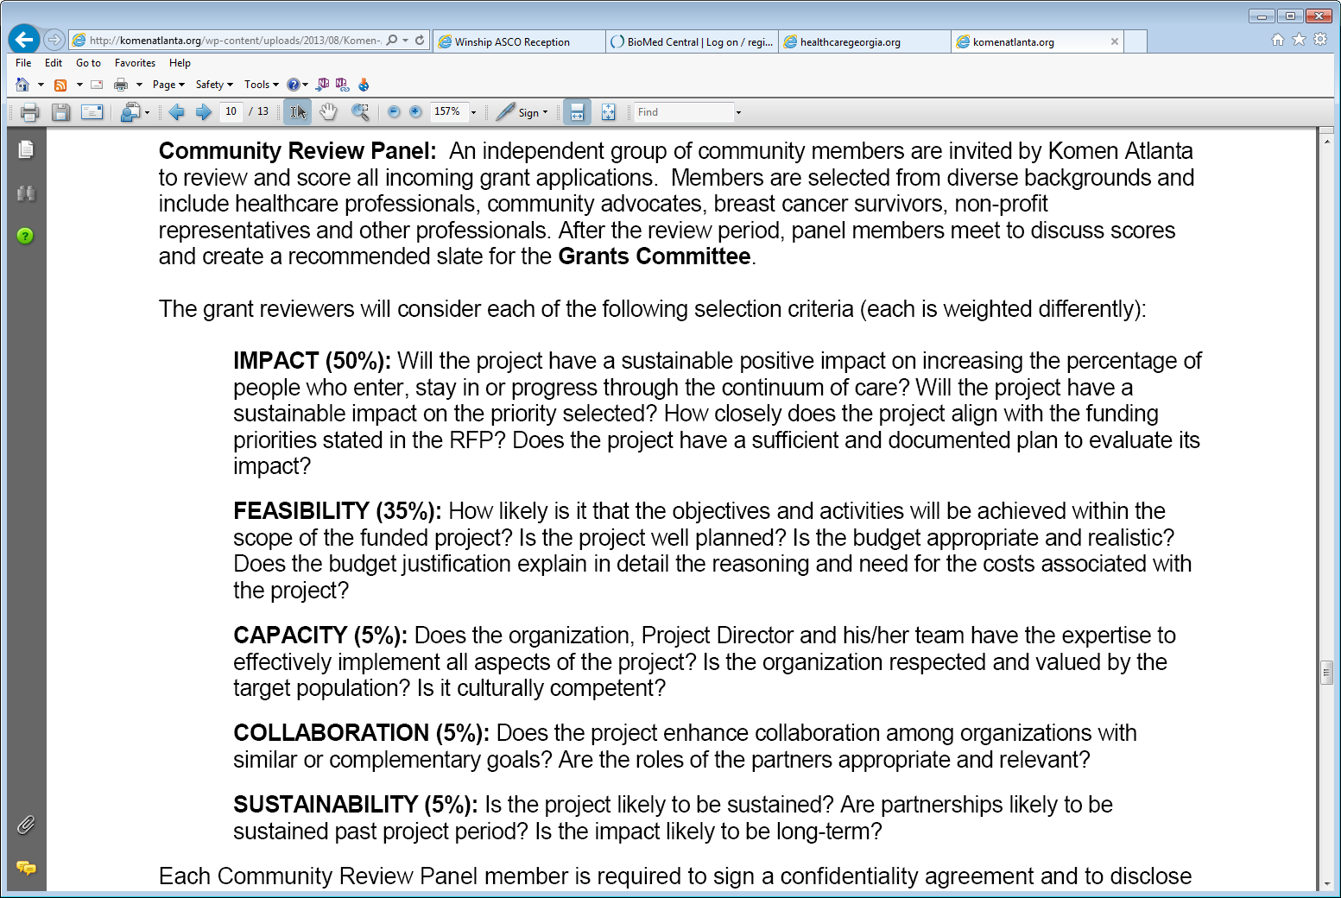
Susan G Komen Greater Atlanta:
Reviewers

Slide 34
Susan G Komen Greater Atlanta

Slide 35


Grant Review: State or Federal Agency

Slide 36
Grant Review:
Governmental Agency
Reviewers receive proposals
Primary and secondary reviewer to discuss their assessments
They provide written comments and/or assign scores
All members of committee vote and assign scores
9-point rating scale (1 = exceptional; 9 = poor)

Slide 37
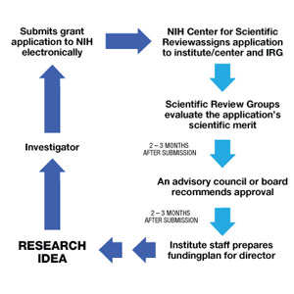
From Idea to Funding: Government Application

Slide 38
National Institutes of Health (NIH)
Review Criteria
Significance- Does the study address an important problem?
Approach- Are the conceptual framework, design, methods, and analyses appropriate?
Innovation- Is the project original?
Investigators- Are the investigators trained to carry out the work?
Environment- Does the scientific environment contribute to the probability of success?

Slide 39
The NIH Peer Review Process
Phases of Process
Impact | Score | Descriptor
High Impact | 1 | Exceptional
 | 2 | Outstanding
 | 3 | Excellent
Moderate Impact | 4 | Very Good
 | 5 | Good
 | 6 | Satisfactory
Low Impact | 7 | Fair
 | 8 | Marginal
 | 9 | Poor
Notes:
39
39

Slide 40
Review Committee
Applicants are provided with a summary statement:
  Reviewer critiques
  Summary of the review discussion
  Priority score and percentile rank
  Administrative comments
  Budget comments

Slide 41
Review Debrief
After grant reviewers have assigned scores and made comments on the submitted proposals, a meeting or teleconference takes place to discuss
The goal of the meeting is to identify the top proposals based on the review criteria
Often there are 1-2 alternates that are also selected in case the funding is declined by the applicant

Slide 42
Review Criteria: What Funders look For?

Slide 43
Overall Considerations for Grant Reviewers
Funders’ Priorities: How well that grant requests meets their (funders) interests?
Organization/Individual Credentials: Whether the applicant organization (board, staff, volunteers) is credible?
Responsiveness of Project:
  Whether the project descriptions fits their goals/priorities?
  Whether the applicant’s time table fits theirs?

Slide 44
Grant Reviewers
Look for all grant requirements!
Quality of narrative that gives enough detail
but is not wordy
A compelling story
Realistic goals and objectives
An appropriate evaluation plan
Realistic allocation of money

Slide 45
Grant Reviewer Questions
Priorities
  Does this project fit funding guidelines and funding areas?
  What is the importance of this project?
  Who is affected by this project?
Project
  Is this project realistic?
  Are the project goals and objectives realistic?
  Can the timeline be met?
  Does this project duplicate others in the field? If there is duplication, why is this project stronger?
Qualifications
  Is the submitting organization able to receive a grant?
  Is the submitting organization capable committed to the project? carrying out the project?
  What is the history of the organization; has it shown success?
  Is the staff of the organization capable and accountable?

Slide 46

Grant Reviewer Questions
Partnership/support
  Is there collaboration involved in the project?
  Do the submitters have external support?
Budget
  Is the cost of this project justified and realistic?
  Will this project be continued when the money is gone?
  Is there collaboration involved in the project?
  Do the submitters have external support?
  Is this an all-or-none type of project, or can we choose to fund portions of it?
  Is this a solid investment for our organization or another?

Slide 47
Q&A
If you have reviewed a grant before, what other criteria or factors did you consider?
Type criteria in chat

Slide 48
Review Decisions: What is the Result?

Slide 49
Grant Reviewers Options
Funded
Funded with amount requested
Funded with a different amount
Accepted
Proposal is accepted but not funded
Rejected
Proposal is rejected

Slide 50
Accepted and Funded
Accepted and Funded
  Official notification by letter or email
  Budget negotiations (based on dollars available)
  Signed letter/contract with conditions of payment
    Sometimes a lump sum
    Most of the time it is over the time period of the grant
    Performance reports are often required for money disbursement

Slide 51
Accepted but Not funded
Request verbatim reviewer comments or if unavailable a summary of review comments
Decide if you should revise and resubmit based on the reviewers’ concerns
  You need to know probability estimates, proposal weaknesses, and time frames
May want to seek another funding source

Slide 52
Rejection
Don’t take it personally!
Request verbatim reviewer comments or if unavailable a summary of review comments
Consider:
  Revision of grant for next cycle perhaps
  Discuss with funder contact:
    Ask if you should reapply next year?
    Keep the funder abreast of your accomplishments over the next year

Slide 53
Review of Training Workshop
Common Grant Sections and Submittal
Grant Review Processes
Common Review Criteria

Slide 54

Questions?
Cam Escoffery, PhD, MPH, CHES
Assistant Professor
Department of Behavioral Science and Health Education
Rollins School of Public Health
cescoff@emory.edu

